Slide 1
BA In Transformation
2020 and beyond:
BA as a Role or a Skill
David Mantica
SoftEd www.softed.com davidm@softed.com

Slide 2
Presentation Agenda
Enterprise Challenges
High-level thought of BA as Catalyst to solve enterprise challenges
Current state of BA role
  What is it
  What governs it
BA role disruption
  Agile
  PMI PBA
  Product Management
Critical Skills (defining need)
  Modeling, Enterprise Analysis, Business Architecture
Business Value Analysis
Position Evolution
  Professional skills
  Being solution architect / trusted advisor
  Career path

Slide 3
Enterprise Challenges
Speed
  Rapid pace of disruption and change
  Can handle change, lose and lose quickly
Productivity
  Key to profits in the face of contact change in need
Competitive Advantage
  Customer knowledge (internal and external)
Product Creation
  Three elements of product creation
    Competitive understanding, organizational capabilities, creating value
Growing, Managing and Retaining Knowledge Workers
  Generation “Y” dilemma (Millennial)

Slide 4
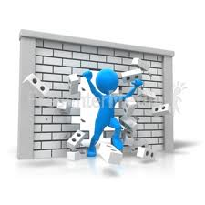
BA is Catalyst to Face/Conquer these Enterprise Challenges

Slide 5
What is a BA? (Industry perspective)
Position Overview
  Enterprise Analysis (business case)
    Project scope
  Process modeling
    Show how things work now and should work in the future
  Requirements Analysis, Elicitation, Management
    Converting from business (functional/non-functional)
    requirements to technical (systems)
  Business Architecture / Business Rules
Position Profile
  Should act a lot like a Product Manager
  Should have solid user knowledge of system, power user
  Should be technical enough to “talk the talk”
  Much more concerned about outcome than budget or schedule
  Should have VERY strong domain knowledge
  Must be able to state/represent business case of system/software

Slide 6
Who or What Governs the BA role?
International Institute of Business Analysis (IIBA)
  www.iiba.org
  Started in Canada,
  15 years old
  BA Body of Knowledge (BABOK)
    Current version 3.0
  Multiple certifications (2 core)
    Certified Business Analyst Professional (CBAP)
    Certification of Competency in Business Analysis (CCBA)
  New PMI-PBA certification potential impacts
Overall
  Still in infancy (took PMP 12+ years to reach tipping point)
  Doers know it and love it. Companies don’t know what it is or offers
  BA position means something slightly different to different organizations
  Adding extensions and connecting to hot things like cybersecurity and data analysis

Slide 7

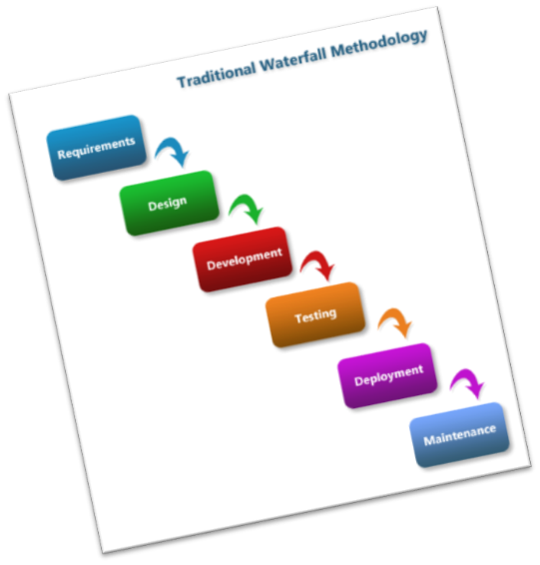
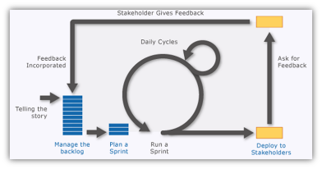
What is Agile??
Important Observation
Plan-driven Development
Adaptive Development
VS.
Notes:
Agile is not a “one-size fits all approach”. The question to answer is “What approach most approximately fits the type of work we are doing here?”
Large complex projects that represent a known problem but an unknown solution are the prime candidates for an adaptive development, Agile approach.
Simple, low risk, straight forward projects that don’t require significant learning to complete are well suited to a plan driven approach.
________________________________________________________________________
________________________________________________________________________
________________________________________________________________________
________________________________________________________________________
________________________________________________________________________
________________________________________________________________________
________________________________________________________________________

Slide 8
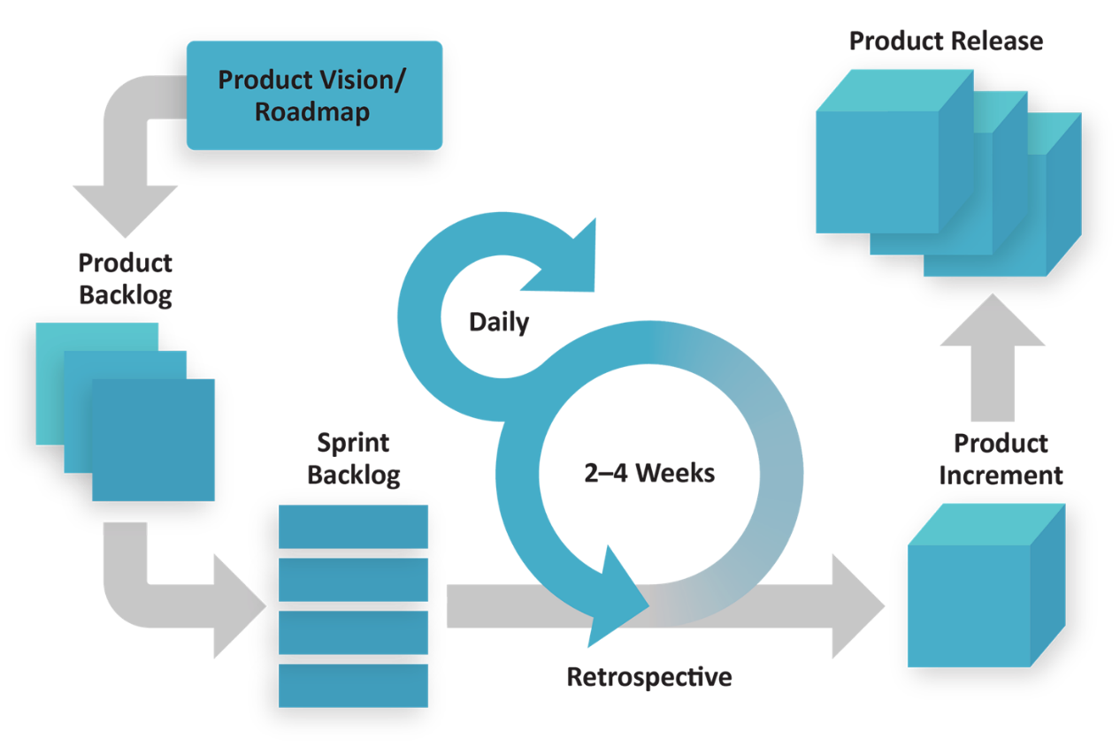
The Mechanics of Scrum, where does BA fit??

Slide 9
BA Role In Iteration
First off, Iterations are work-specific, not role-specific
Work specific BA actions include:
  Chunk requirements into User Stories
  Provide input on need and prioritization of Stories
  Write non-functional test cases
  Perform non-function tests / acceptance tests
  Write specifics
  Write documentation / training
Product Owner and BA not the same thing
In Iteration, work focuses on only one aspect of the BA skill set.
In Agile a lot of the role is in and around Iteration zero or the before iteration planning work

Slide 10
Is BA Work A Role or a Skill?
IIBA (International Institute of Business Analysis)
  Sees the BA (Business Analyst) as a role
  Specific function in defining what is going to be done and how it is going to be done
Agile (the way of working)
  Sees the BA (business analysis) as a skill
  Focused around writing and managing requirements and testing output at user interface level
  Sometimes replace BA with Product Owner
How does PMI see BA Work?

Slide 11
PMI-PBA Demographics and Certification Vision
Based on the make up of the PMI-PBA designation PMI sees the BA as a skill
  It is something that can be added to a professional’s set of skills and tools
  Anyone in the SDLC and beyond can gain these skills based on their experience level
  The skills certified are tied to “in project” BA work
  The skills are transfer to what is needed in an agile production environment

Slide 12
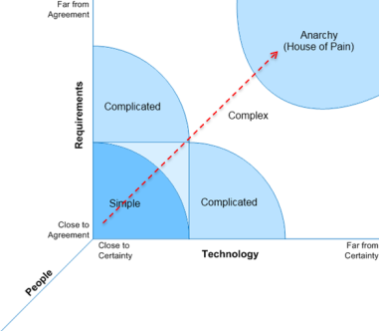
How do I get what I want from my efforts?
Why is this conversation important
Where does software development fit?
Notes:
The Stacey Matrix is a model proposed by Ralph Douglas Stacey to determine the characteristics of work based on the degree of certainty and the level of agreement. People do the work, and they have to deal with requirements and technology. Requirements represent the “What” we want to do or deliver. Technology represents “How” or the delivery architecture. The delivery architecture is made up of processes and tools. These can be highly sophisticated or simple. By understanding the work characteristics we can understand the approach that best fits the work. Simple things can be accommodated by defined processes successfully, but as things get more complex, the way we approach the work needs to account for the need to learn. Agile is built for the need to learn. A helpful question: “Is it a widget or is it invention?” When it is a widget, that represents a known thing that we want to replicate. When it is invention, we don’t really know what it is, or what it needs to be. Invention requires learning to be successful. Invention also requires failing fast so that we don’t fail slow. Edison was reportedly asked how it feels to have failed over 10 thousand times inventing the light bulb. His answer was that he didn’t fail 10 thousand times, he found 10 thousand ways that didn’t work. If each failure was slow, like it took 9 months per failure, do the math, Edison would not have been the one to provide the light bulb. He wouldn’t have lived long enough. Invention requires fast failure or fast feedback cycles which create fast learning.
________________________________________________________________________
________________________________________________________________________
________________________________________________________________________
________________________________________________________________________
The Stacey Matrix

Slide 13



New Project Law: s + s + $ Does Not = ☺
New Project Law
on time
all scope
within budget
happy customer
Schedule:
Scope:
Budget:
Project delivered within the timeframe originally identified
No date slips
Every milestone achieved
Everything originally requested is delivered
Everything delivered works perfectly as the customer requested, no bugs
Did not spend a single cent more than originally estimated to spend
Did not need any additional resources, hardware, etc. throughout entire project
=
/
+
+
=
/

Slide 14
BA Role Current Status:
Too Much Science Not Enough Art
It seems the focus has been the measurable side of a BA’s responsibilities…
  ”if it can be measured, it can be monitored and if it can be monitored it is important”
  Inside Agile – Way too much focus on requirement breakdown (Stories), Testing and documentation
  Outside Agile – Way too much focus on requirements elicitation and development
Anecdotal: 95% of people in our classes focus just on the science side of role
But missing the growth to becoming a TRUSTED ADVISOR. Enterprise Analysis/Solution Architect/Management Consultant
    What is this??

Slide 15
BA Trends: “Out of Project”
  Future State Modeling
    Automation process and data flows
  Enterprise Analysis
    Reviewing solution options
    Business case development
  Business Architecture
    Organization strategy and function by business unit
    Planning organization adjustments based on automation / project goals before project execution
    In-depth understanding of business capabilities and functions
  Business Value Analysis / Product Management

Slide 16
BA Trends: Models and Analysis
Automation drives productivity and productivity drives profitability
But Automation screws up processes
Processes run companies—automate without process redefinition means HUGE WASTE
What a BA must do:
Build future state, modeling both process and data flow
  Does it work / will it work ?
Drive top / down agreement on new processes and data flow
Align requirements to new process
Push acceptance of new process flow

Slide 17
BA Trends: Enterprise Analysis
Defining Need
  Are there other internal options
  Is there a return on investment and what is it
  Can the organization do what is requested
  Basically building the business case
Proper Enterprise Analysis drives Executive sponsor behavior
  Negotiate need using appropriate analysis techniques on the initial request
  Provide leadership to bring disparate executive stakeholders together for informed project initiation
Enterprise Analysis isn’t always part of BA’s responsibilities
  BA’s in those organizations are given the project initiate and goal and told the model and the solutions and gather the necessary requirements
Elements of Traditional Product Management
  ICAgile Product Management designation
  https://www.icagile.com/Business-Agility/Operating-with-Agility/Product-Management

Slide 18
BA Trends: Business Architecture
What is it?
  A “blueprint” of the enterprise that provides a common understanding of the organization and is used to align strategic objectives and tactical demands
  A bridge between your business model / strategy and how your business functions
What does a Business Architect work on?
  Supports the definition of business strategy and tactical goas that drive organization operations
  Documents business capabilities and primary functions
  Develops root cause analysis to review enterprise business problems
  Captures an organization view and documents roles, responsibilities, capabilities of business unites
TOGAF (The Open Group Architecture Framework) is a community-based standards effort to describe methods and tools used by architects

Slide 19
What is Value Management?
Distinct discipline
Applies at many levels
Crosses many initiatives
May be embodied in many roles
Different aspects of value
Value
Delivery
Process
Notes:
Notes:
What is Value Management?
We often focus on the Agile processes and the delivery of working software but there is a real discipline in managing the value that we derive from initiatives.
In this course we will focus on the management of value, ensuring that we provide the right guidance to our teams so they can produce the right software and maximize customer value.
As organizations, we often lose sight of what we really want to achieve with our initiatives – generate value.
Learning Objectives:
1 Value Management as an Agile Discipline and Craft 0.5
1.1 The Need for Value Management
1.1.1 What is Value Management
Many organizations lose sight of value in their initiatives. While there are a variety of roles who are in theory tasked with ensuring value is delivered often the responsibility ends up being diluted and not focused on.
The purpose of this LO is to introduce the learner to the concept of value management as a distinct discipline which applies at many levels, crosses many initiatives and may be embodied in many roles.
To be acceptable this LO should introduce the learner to the concepts of value management and the ideas of many different aspects of value. (Possibly through an interactive activity)
Source:
- Image: Microsoft clip art

Slide 20

Value Management Challenges
Everyone responsible for value, so no one is
Responsibility gets diluted
Lose sight of value of initiatives
Not viewed as a distinct discipline
Limited definition of “value”
The Need for Value Management
What is Value Management
Notes:
Notes:
Managing Value Pitfalls
There are many different pitfalls in managing value across organizations. Here’s a few:
Learning Objectives:
1 Value Management as an Agile Discipline and Craft 0.5
1.1 The Need for Value Management
1.1.1 What is Value Management
Many organizations lose sight of value in their initiatives. While there are a variety of roles who are in theory tasked with ensuring value is delivered often the responsibility ends up being diluted and not focused on.
The purpose of this LO is to introduce the learner to the concept of value management as a distinct discipline which applies at many levels, crosses many initiatives and may be embodied in many roles.
To be acceptable this LO should introduce the learner to the concepts of value management and the ideas of many different aspects of value. (Possibly through an interactive activity)
Source:
- Image: Microsoft clip art

Slide 21
Levels of Value Management
Business Stewardship
Business Value Analysis
Expert-Value Management
Value-Based Solutions Delivery
Portfolio Focused
Value Management and Program Management
Key Agile Practices
Requirements, Prioritization, Roadmap
Single initiative, project, team focus
Value Management Team
Portfolio Management
Customer Focused
Maximize Value
Establish Value Teams
Value-Based Approaches
Notes:
Notes:
Business Stewardship: work done at the level of a single initiative/project/team
Value Management: applies to a wider Portfolio level focus
Learning Objectives:
1 Value Management as an Agile Discipline and Craft 0.5
1.1 The Need for Value Management
1.1.2 Levels of Value Management
Value Management occurs at multiple levels. ICAgile uses the term Business Stewardship to refer to work done at the level of a single initiative/project/team and Value Management to apply to a wider Portfolio level focus
The purpose of this LO is to introduce the learner to the two levels of value focus, the difference between organization wide portfolio focused
To be acceptable this LO should clearly distinguish the difference between the role and responsibilities of Business Value Analysis vs. Business Value Stewardship

Slide 22
Role, Not Job Title
Value Management
Right Information
Right Level
Right Time
Right Product
1.4.1
IIBA , Becoming a Business Analyst
Notes:
Notes:
Value Management ensures the right information is available to the development team at the right level of detail at the right time so they can build the right product. --- and that value is delivered to the customer at the right time and expectations ???
Value Management is a role, not a title like Business Analyst, Product Owner, Agile Analyst.
It is a role that must be fulfilled to ensure value is delivered by ensures the right information is available to the development team at the right level of detail at the right time so they can build the right product and that value is delivered to the customer at the right time and expectations
IIBA: Becoming a Business Analyst
Agile Analyst
In the agile world, software requirements are developed through continual exploration of the business need.
Requirements are elicited and refined through an iterative process of planning, defining acceptance criteria, prioritizing, developing, and reviewing the results.
Throughout the iterative planning and analysis of requirements, business analysis practitioners must constantly ensure that the features requested by the users align with the product's business goals, especially as the business goals evolve and change over time.
Agile business analysis is about ensuring the right information is available to the development team in the right level of detail, at the right time, so they can build the right product.
Irrespective of job titles, business analysis is about ensuring the project is able to deliver the maximum value for customers and adapting to the evolving business needs.
When new to the Agile Analyst role, a business analyst looks for guidance from more senior Agile Analysts to ensure his/her work is complete.
This role will assist in larger projects but only with supervision.
Learning Objectives:
1 Value Management as an Agile Discipline and Craft 0.5
1.4 Role, Scope, and Diversity 0.5
1.4.1 Role, Not Job Title
Value Management ensures the right information is available to the development team at the right level of detail at the right time so they can build the right product. --- and that value is delivered to the customer at the right time and expectations ???
The purpose of this LO is to understand that the scope of the role of VM&BA in an Agile organization is to identify the most valuable business needs. It includes learning to differentiate between the most valuable and the less valuable outcomes, and how to communicate valuable outcomes so that the team can deliver the right change.
To be acceptable, this LO must provide learners with the opportunity to relate or contextualize the Business Value Steward role in their own work context.
Source:
https://www.iiba.org/Careers/Becoming-a-Business-Analyst/BaBA/Driving-Your-BA-Career-Roles.aspx
Image: Microsoft clip art

Slide 23


BVA has a Foot in Two Worlds
Discovery:
  See the Whole, Think as a Customer, Analyze to Determine What is Valuable
Delivery:
  Get Real with Examples, Understand What is Doable, Stimulate Collaboration
Delivery
Discovery
IIBA, BABOK Agile Extension
Notes:
Notes:
From IIBA BABOK:
The principles that guide successful business analysis can be categorized into two distinct frameworks:
the Discovery Framework and
the Delivery Framework.
The Discovery Framework deals with the whats and the whys of the product. Effective discovery is supported by three underlying principles:
See The Whole,
Think as a Customer, and
Analyze to Determine What is Valuable.
The Delivery Framework deals with the hows and the whens of the product. Effective delivery is supported by four underlying principles:
Get Real Using Examples,
Understand What is Doable,
Stimulate Collaboration and Continuous Improvement, and
Avoid Waste.
Please note that these guiding principles are meant as a guide and not necessarily as hard and fast rules. For example, while Get Real Using Examples is included in the Delivery Framework, the techniques described in this principle can certainly prove effective within the Discovery Framework as well.
Learning Objectives:
1 Value Management as an Agile Discipline and Craft 0.5
1.4 Role, Scope, and Diversity 0.5
1.4.5 Big Picture View
Many roles in an Agile project consciously focus on the current iteration of work. The Business Value Analyst must take both long and short term perspectives.
The purpose of this LO is to understand and apply techniques that enable an understanding of both the big picture view and how the current work aligns with the big picture. This includes communicating the big picture and alignment with the rest of the team.
To be acceptable, this LO must provide learners with the opportunity to understand appropriate strategies to take a holistic view of the work and how this relates to their own work context.
Source:
Image: Microsoft clip art
IIBA, BABOK Agile Extension

Slide 24

The BA Evolutionary Model
“In Project” to “Out of Project”

Slide 25
What Makes you Successful Can Also Hurt You
Typical SDLC Professional Characteristics
  Detailed (accurate)
  Black / White (there is a right and wrong way)
  Professional not Management
    Don’t have distraction of staff
  No Authority
    Is seen as unbiased
Puts position at a disadvantage when moving to Trusted Advisor / Mgmt. Consultant role / Product Management Role

Slide 26
Professional Skills Buildup
Influence
Change Management
Facilitation and Negotiation
Conflict Management
Emotional Intelligence

Slide 27
Trust Advisor / Internal Mgmt. Consultant
  Define solution options
    Internal or external – find need with sponsors
  Drive scope definition
  Define future state process
    Process flows / business rules
  Prices / cost definition
    Deep understanding of internal cost, need and Return requirements
  Presents offer
  Pass detailed requirements development to “in project” team

Slide 28
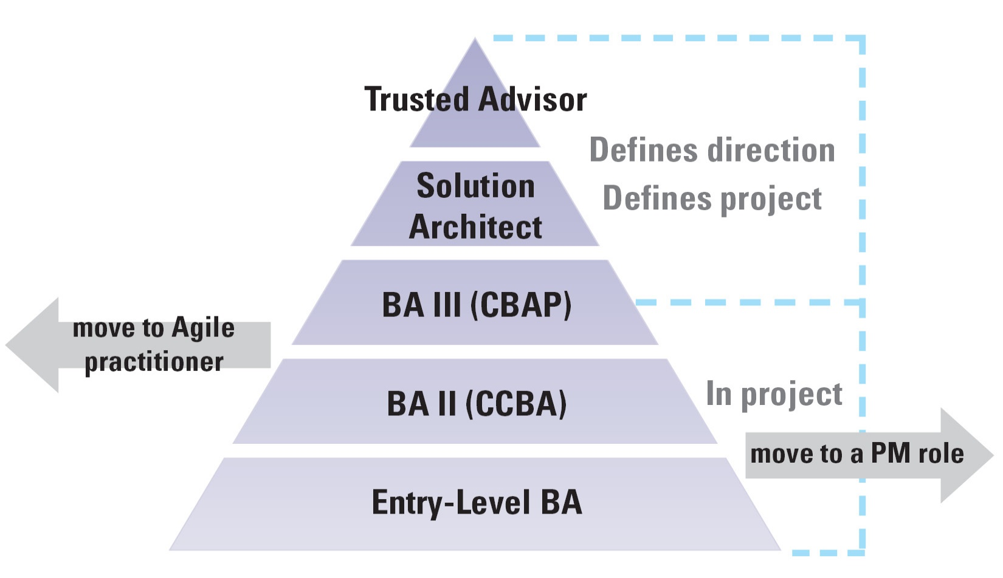
BA Career Path

Slide 29
Questions and
Chapter sponsor/partner SoftEd is offering selected PMI chapters and its membership 50% off discounts on its Live Online training for the rest of the year.
SoftEd offers Business Analysis, Agile, DevOps and Software Testing Training and it is the world’s largest provider of IC Agile training courses. For more information about SoftEd’s public schedule go to:
https://www.softed.com/us/calendar/
You can register using the code DM0620.
Feel free to contact davidm@softed.com

