Slide 1
PMI Central Alabama Chapter Meeting
9/18/2018
Guest Speaker:
Greg Cottrell
Clinical Instructor, The University of Alabama
Email: gpcottrell@ua.edu

Slide 2






About me
Education:
Work Experience:

Slide 3
Failure: What is it really?

Slide 4
Failure is not an option:
it is an inevitability!

Slide 5
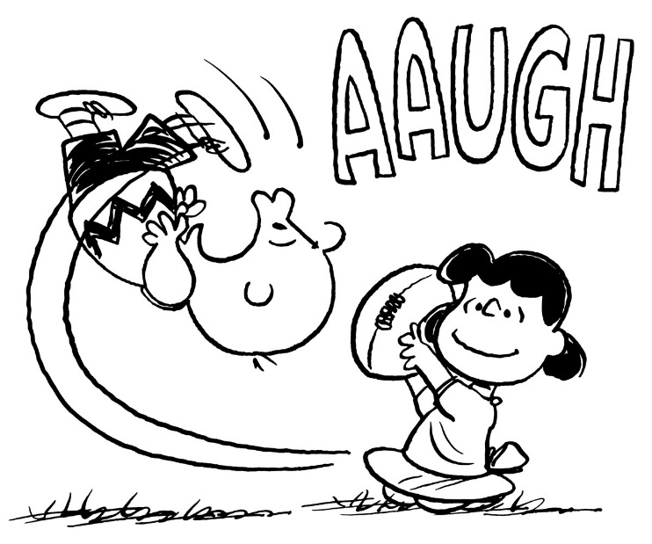
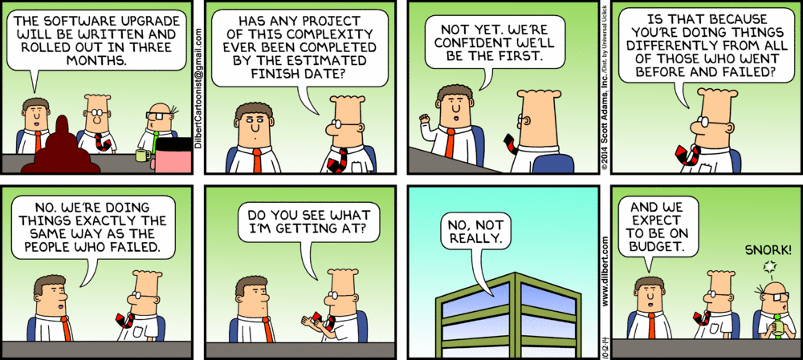
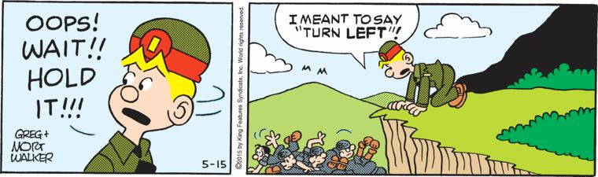

Slide 6
How common is failure, really?
Approximately only 40% of projects meet schedule, budget, and quality goals
Group of recent studies puts the success of change initiatives at around 30% (on time, on budget, with expected outcome)

Slide 7
But what do you mean by “failure”?
Define “failure”...?
“Failed” vs. “challenged”
Who gets to define failure?
  The client? (Which client?)
  The project team?
  Management? Executives?
  You?
“Failure” can have as many definitions as “success”!

Slide 8
Common definitions of failure...
Project fails to deliver on requirements
Project fails to meet time, quality, and/or budget goals
Project fails to meet financial forecasts or ROI targets
Project fails to meet stakeholder expectations

Slide 9
Is “failure” always a bad thing?
“If you're not failing every now and again, it's a sign you're not doing anything very innovative.”
-Woody Allen
“Failure happens all the time. It happens every day in practice. What makes you better is how you react to it.”
-Mia Hamm
“Success is 99 percent failure.”
-Soichiro Honda

Slide 10
Catastrophe
“Silver lining”
opportunity for recovery, learning, & growth
severity
(Oops)
“Failing forward”

Slide 11
How to “fail forward”...
Fail with intent
Fail fast, small, and cheap
Learn from your results!

Slide 12
Scary stats
In a study of 5,400 large scale IT projects (projects with initial budgets greater than $15M):
17 % of large IT projects go so badly that they can threaten the very existence of the company
On average, large IT projects run 45% over budget and 7% over time, while delivering 56% less value than predicted

Slide 13
Question:
Who might consider
this project a “failure”,
and why?

Slide 14
Different stakeholders may have different (possibly conflicting!) goals
The customer (internal or external)
  Your “customer” is usually not a single entity!
Your customer’s customers
Your customer’s owners, investors, or taxpayers
The project team
Management and executives
Regulators / auditors

Slide 15
Takeaways...
Failure has no universal definition
One person’s “failure” is another person’s learning opportunity
In an argument about “success” and “failure”, the person who writes the check usually wins

Slide 16
Activity:
Identify a “failure”, big or small, in your past projects.
Consider the perspective of different stakeholders.
What is something you can learn from this failure?

Slide 17
Failure in IT systems

Slide 18
Simple systems fail reliably
Physical components (hard drives, memory, network connections, etc) are guaranteed to fail eventually
Some portion of manually entered data will be invalid
The power will eventually go out
Cloud-based services do have outages
Physical documents will be damaged or lost
Limited security breaches are practically inevitable

Slide 19
Simple failures can be planned for!
Measure the frequency of failures through logging and reporting
Build additional capacity and/or backup systems in anticipation of failure
Fail gracefully -- automate “clean” system responses to failure
Isolate failures as much as possible through loose coupling
Test failure conditions thoroughly

Slide 20
Complex systems fail unexpectedly
Systems at scale often have unintuitive behavior (“ghost in the machine”)
Components develop complex relationships; “butterfly effect” is common
Failures in one part of the system can cascade to other areas

Slide 21
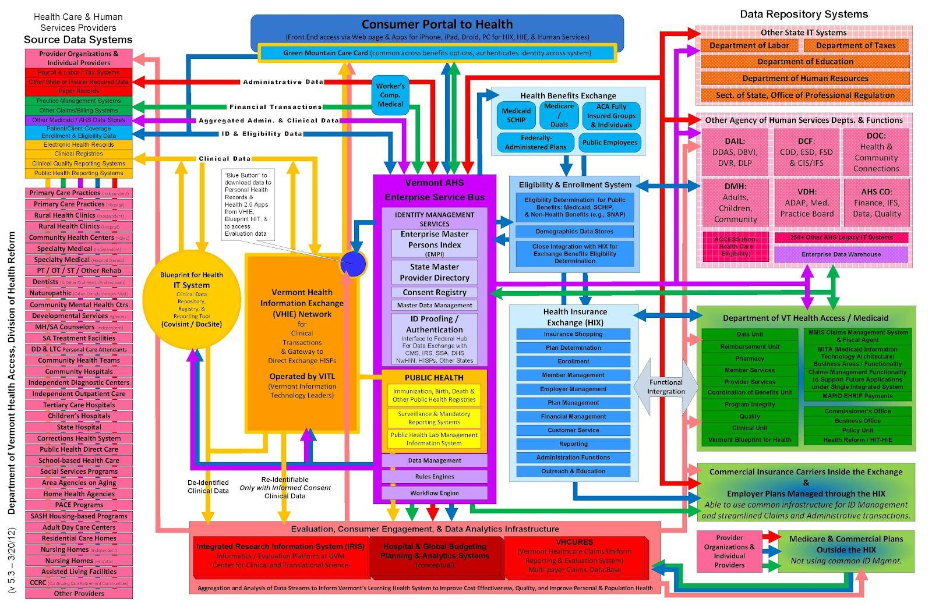

Slide 22

“Black Swan” events
An Event that comes as a surprise, has a major effect, and is often inappropriately rationalized after the fact with the benefit of hindsight.
“It was bound to happen.”

Slide 23
Complex failures can be mitigated!
Use loose coupling to separate independent systems
Build in excess capacity
Use “circuit breaker” conditions to prevent runaway processes
Build in service degradation under load
Provide redundant paths for critical information
Force constant testing and improvement by artificially creating failure (“Chaos Monkey”)

Slide 24
Information quality is important
Maximize value of information
Communications
Reports
Meetings
Highlight what is most important
Be aware of blind spots and call attention to them!

Slide 25
Information volume is important
When approaching a problem, limit the quantity of information if possible
Make critical information the most visible
Keep less important information available for those who need it
“Information radiator”

Slide 26
Questions?
Greg Cottrell
Email: gpcottrell@ua.edu

